Slide 1
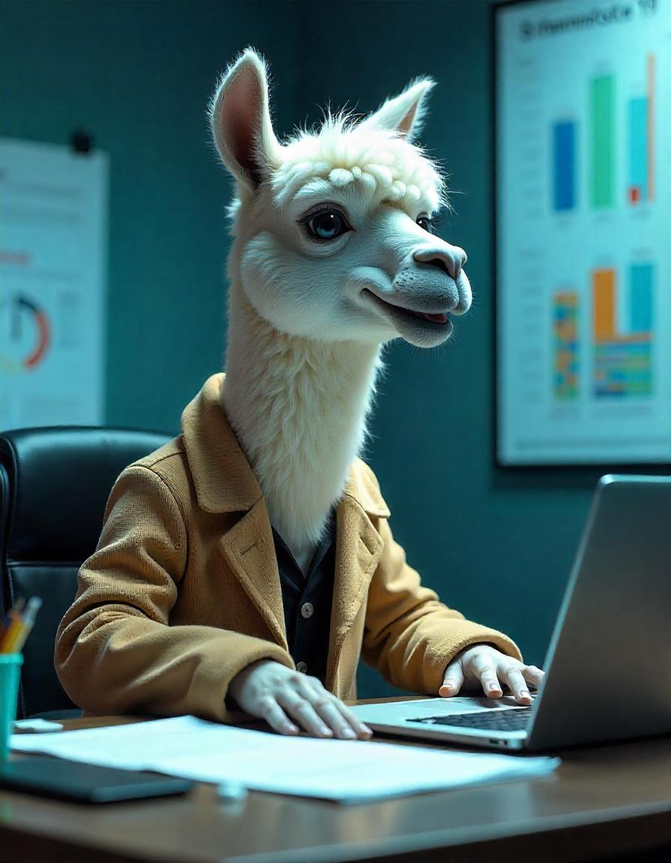



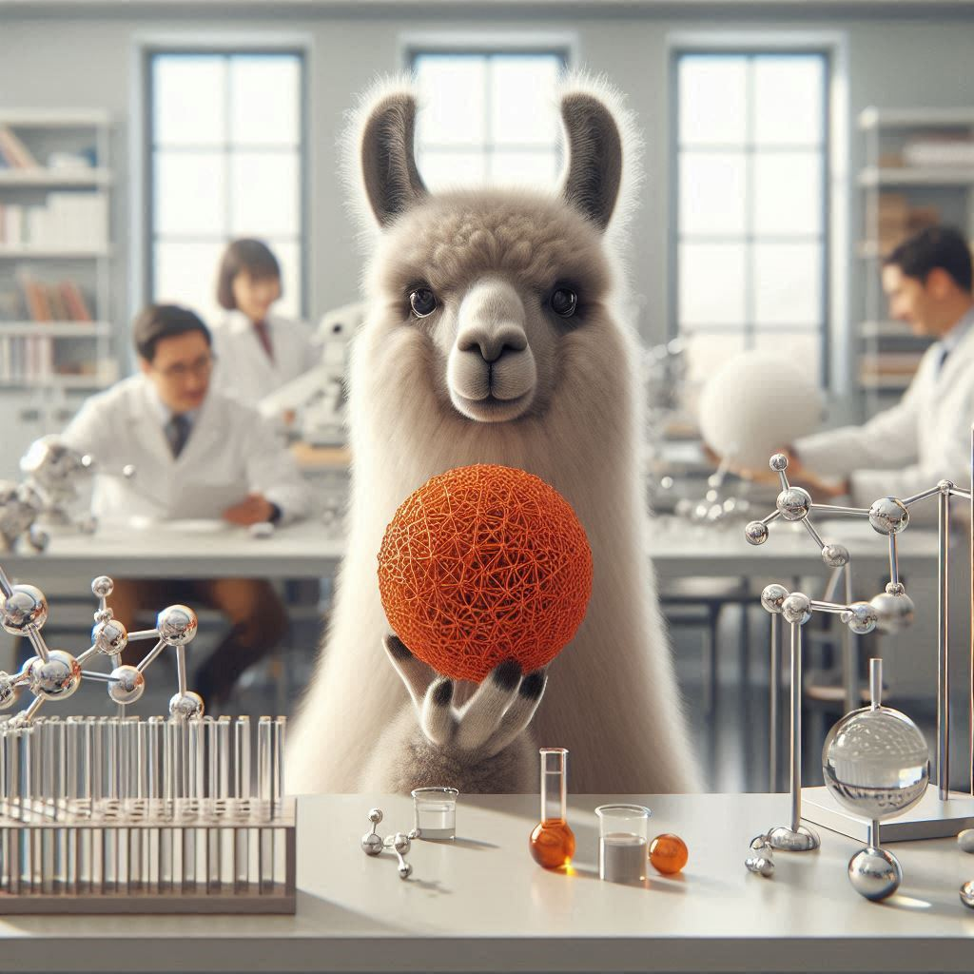


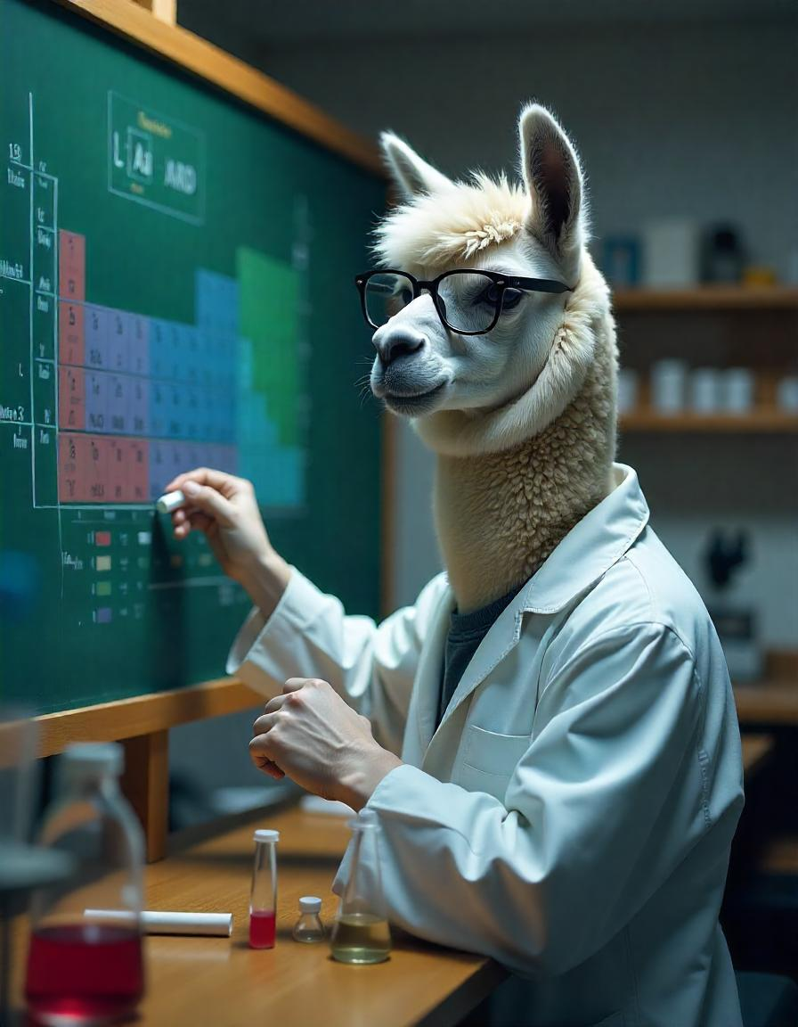
R2CID DATABASE

Slide 2







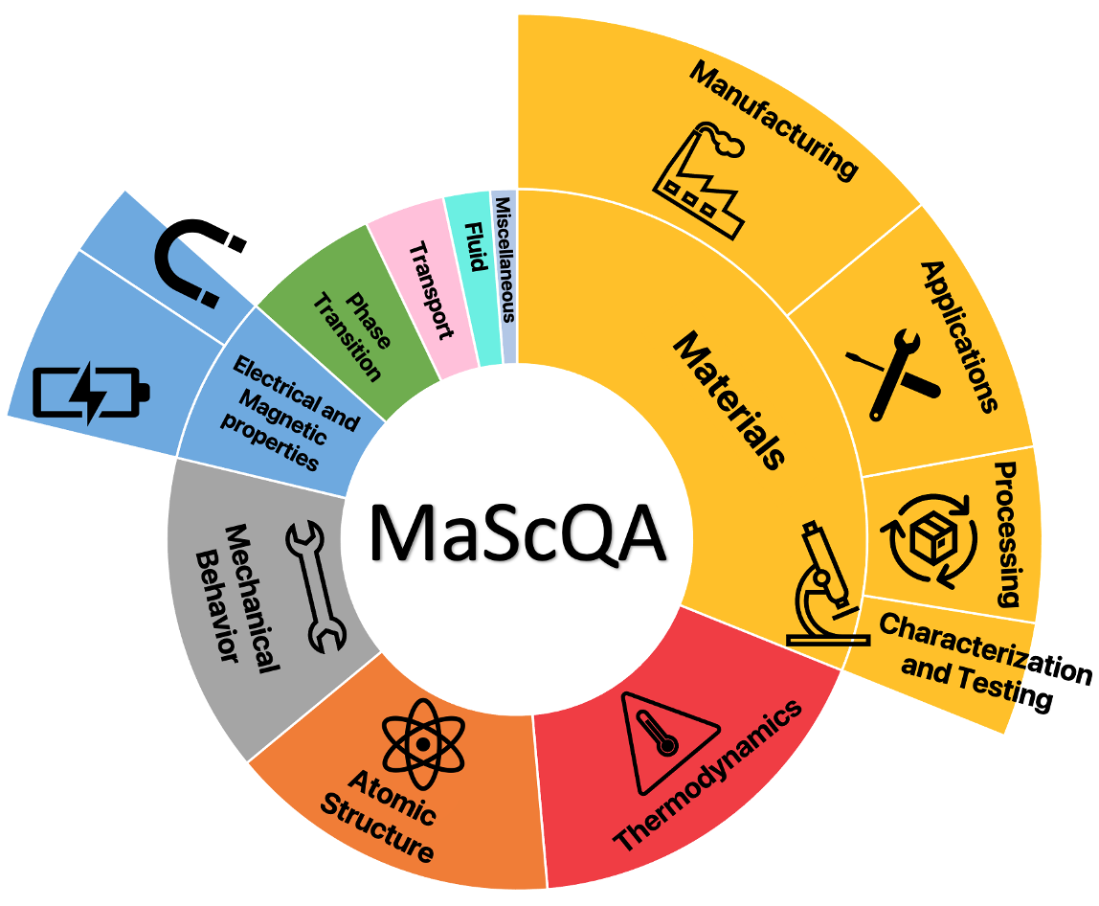
LLaMat : Large Language models for Materials science
PRETRAINING
DATASETS
MODELS DEVELOPED
LLaMat-2-7B
LLaMat-3-8B
LLaMat-2-7B-CHAT
LLaMat-3-8B-CHAT
LLaMat-2-7B-CIF
LLaMat-3-8B-CIF
APPLICATIONS
MatNLP
Materials Natural Language
Processing
R2CID DATABASE
INSTRUCTION FINETUNING
DATASETS
MatSIE
Materials Structured Information
Extraction
MatCG
Materials Crystal Generation

Slide 3
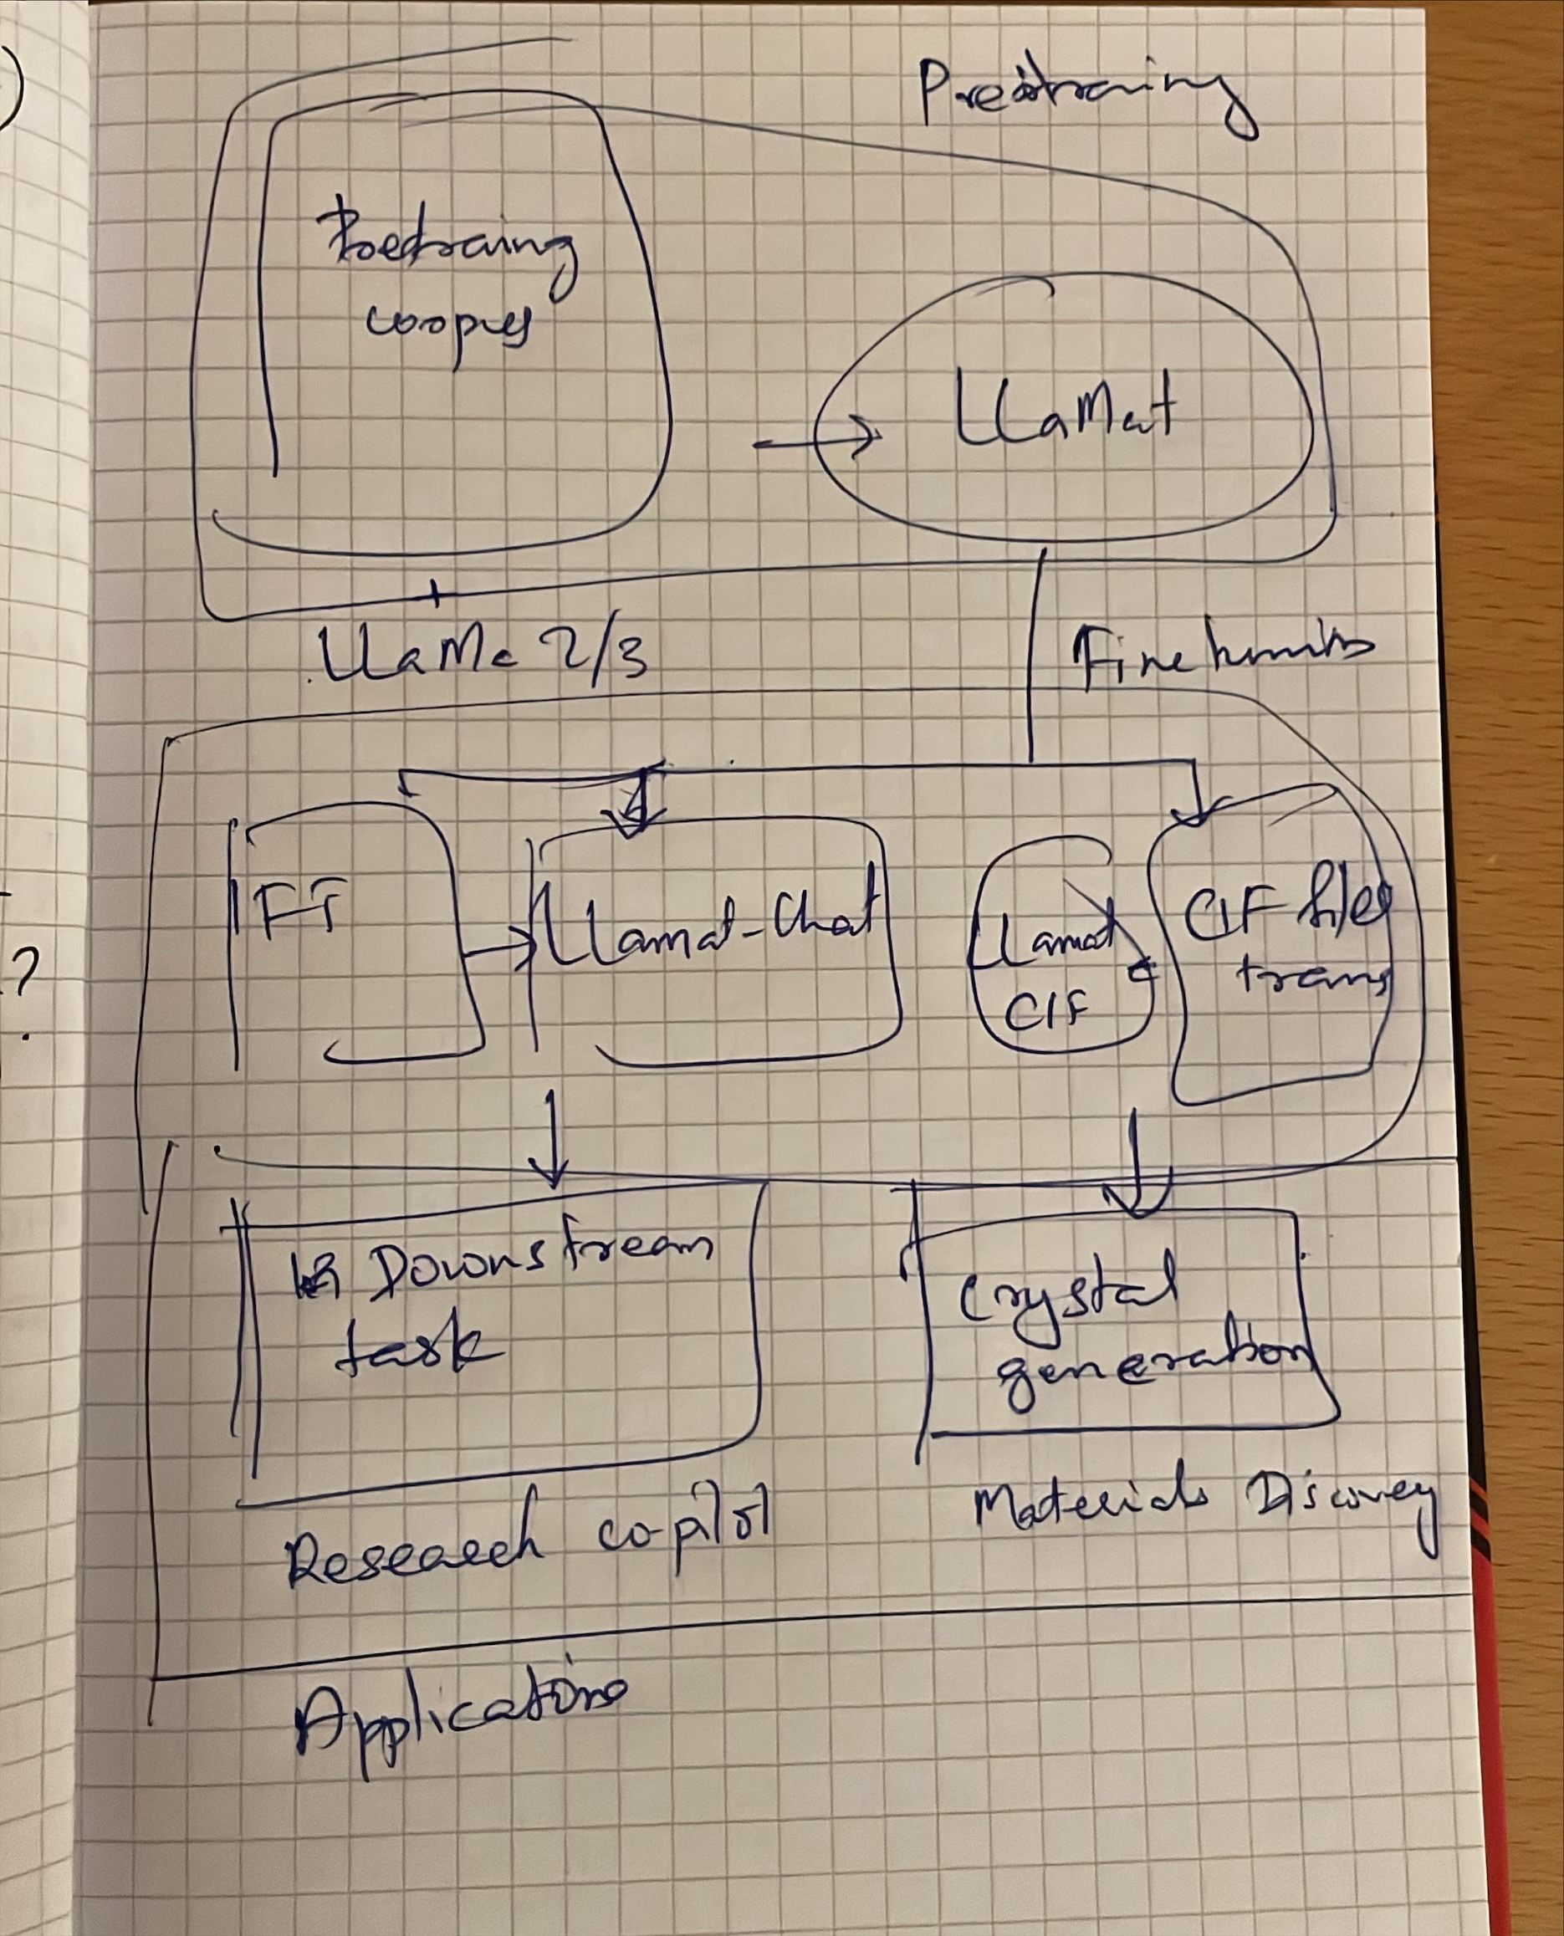




Slide 4
LLaMat
Large Language model for Materials science
_database_code_amcsd 0018049
_chemical_formula_sum 'Si O2’
_cell_length_a 4.913
_cell_length_b 4.913
_cell_length_c 5.405
_cell_angle_alpha 90
_cell_angle_beta 90
_cell_angle_gamma 120
_cell_volume 112.985
_exptl_crystal_density_diffrn 2.649
_symmetry_space_group_name_H-M 'P 31 2 1’
loop_
_atom_site_label
_atom_site_fract_x
_atom_site_fract_y
_atom_site_fract_z
Si1 0.465 0.000 0.333
O1 0.415 0.272 0.213
R2CID DATABASE
LLaMat - Chat
OpenORCA
Math QA
MatBookQA
MatSci-Instruct
Named entity recognition
Relation extraction
Event extraction
Question answering

Slide 5

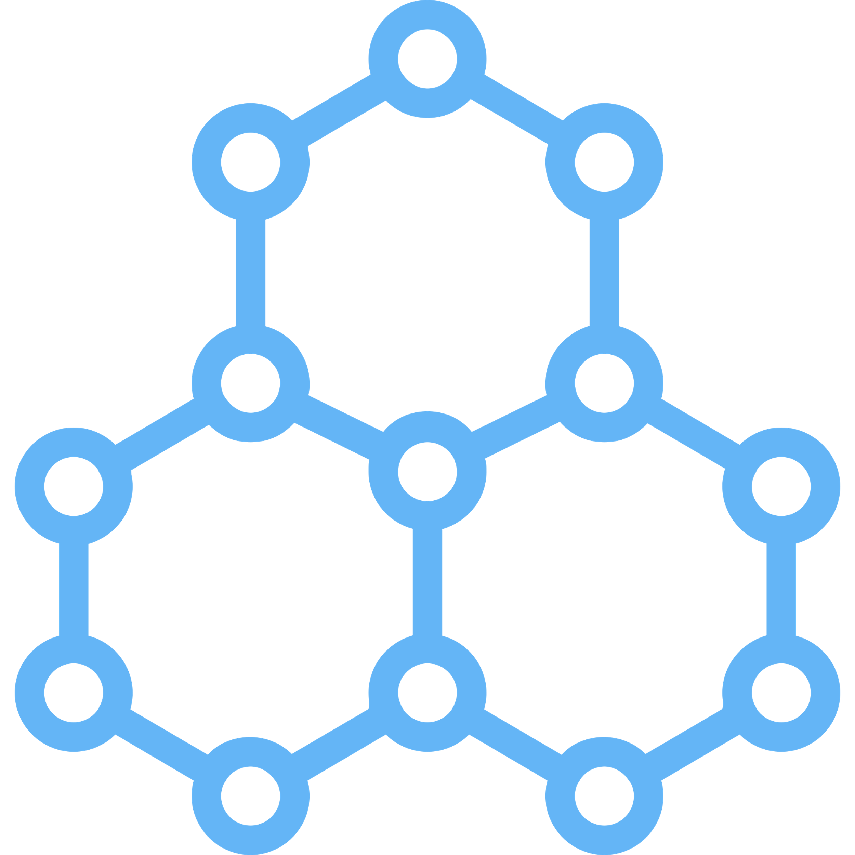
_chemical_formula_sum ‘Si O2’
_cell_length_a 4.913
_cell_length_b 4.913
_cell_length_c 5.405
_cell_angle_alpha 90
_cell_angle_beta 90
_cell_angle_gamma 120
loop_
_atom_site_label
_atom_site_fract_x
_atom_site_fract_y
_atom_site_fract_z
Si1 0.465 0.000 0.333
O1 0.415 0.272 0.213

Slide 6

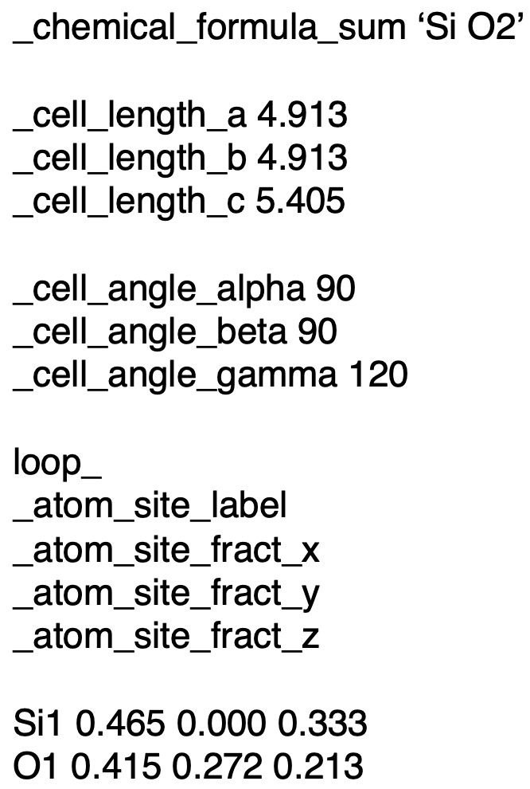

PRETRAINING DATASETS
Research papers from peer-reviewed journals
Materials Science Community Discourse
Crystallographic
Information Files
RedPajama

Slide 7
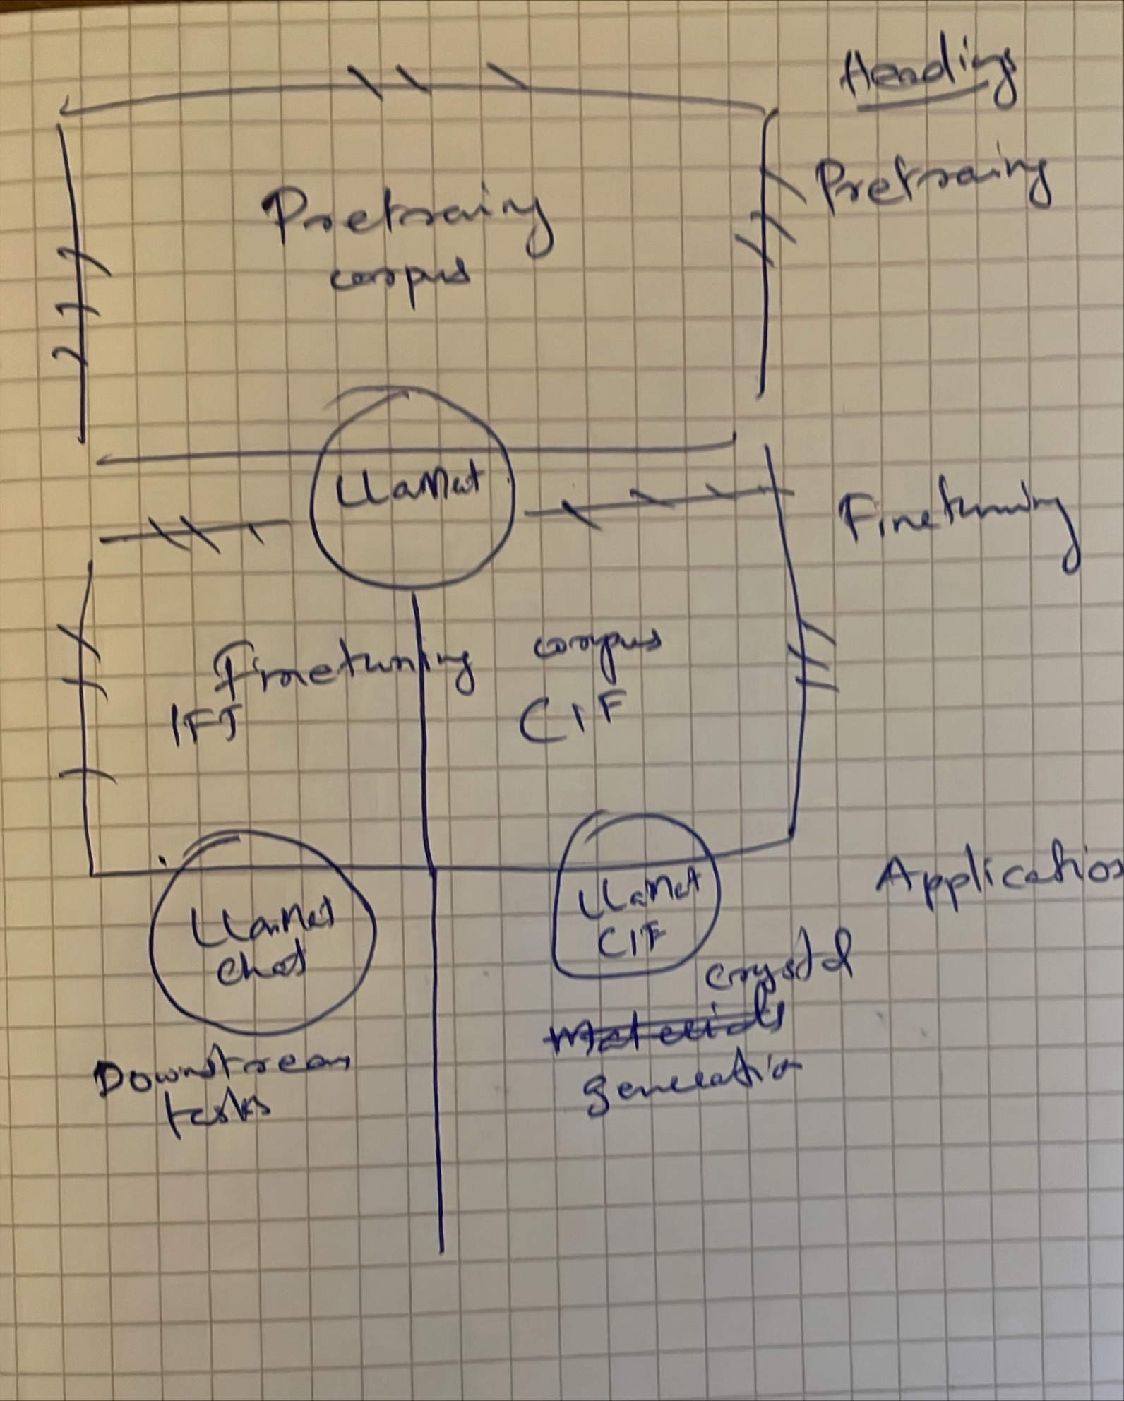


Slide 8




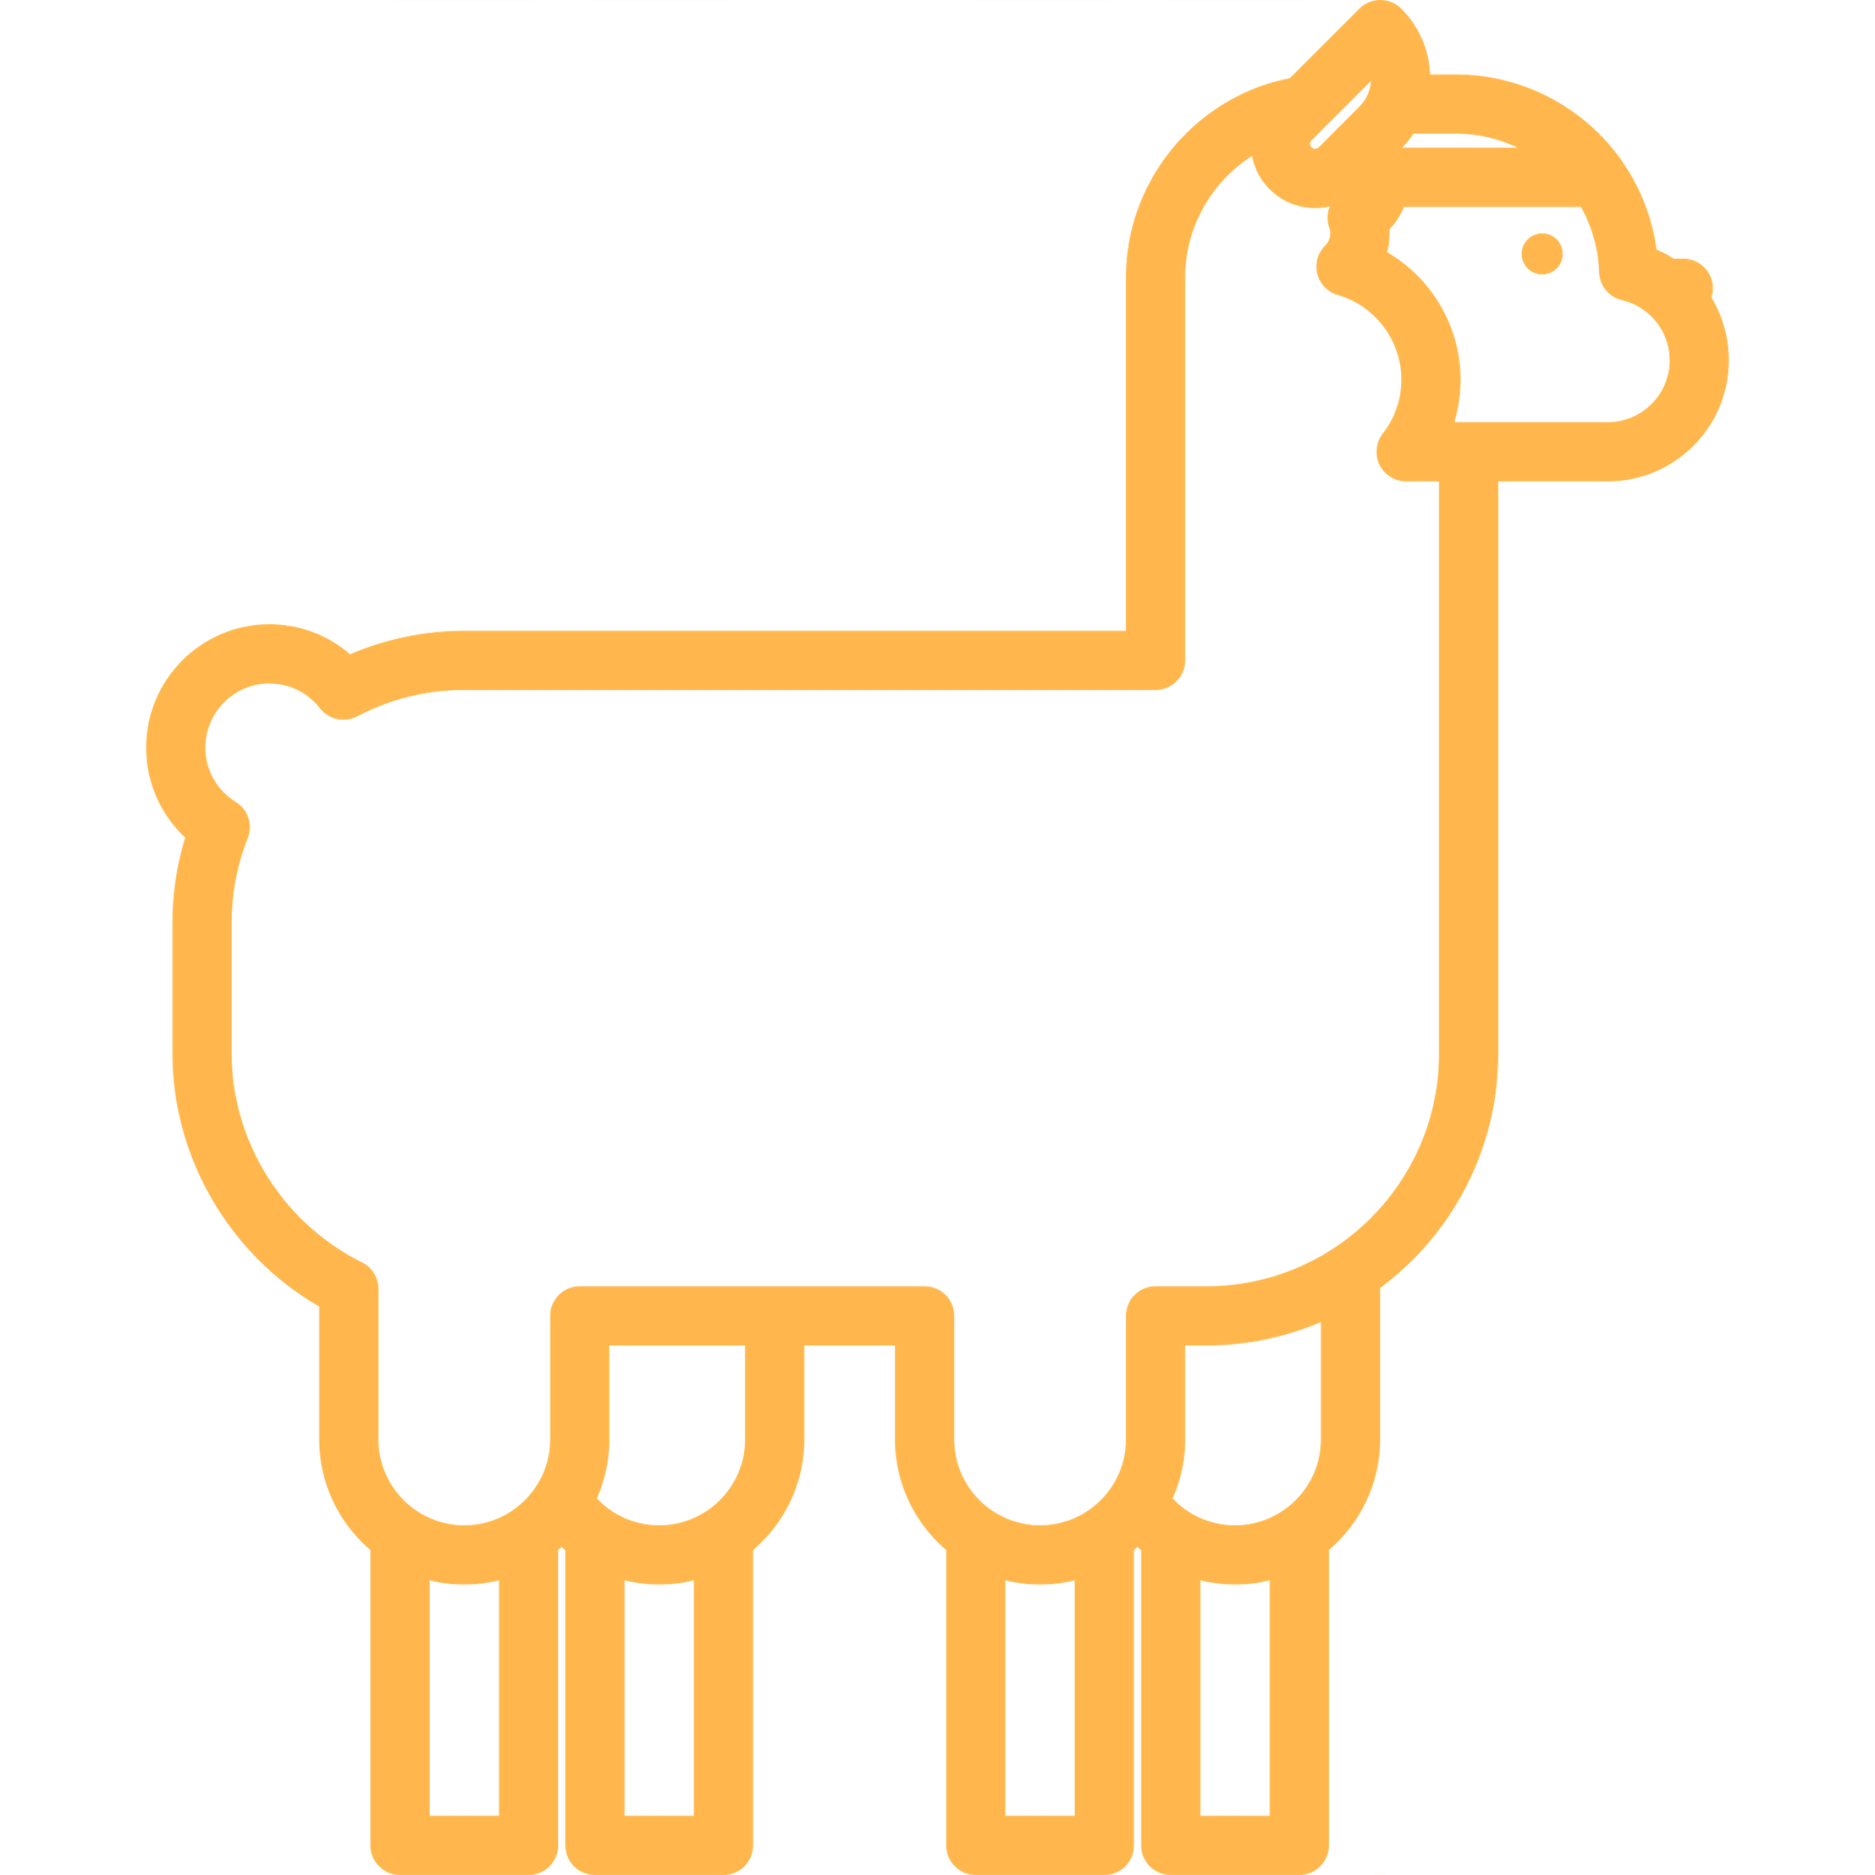
L
L
a
M
a
t

Slide 9
LLaMat

